Slide 1
Motor & Encoder Mounting Guide

Slide 2
Bill of Materials
1. 10:1 Micro Metal Gearmotor HP item # 999 X 2
2. Pololu Micro Metal Gearmotor Bracket Extended Pair item #1089 X 2
3. 2-56 x 20mm Philips head screw X 4
4. 3D Printed wheel X 2 (.stl file provided)
5. 3D printed motor mount X 1 (.stl file provided)
6. 3D printed skate pad X 2 (.stl file provided)
7. encoder PCB X 2
8. AS5304A encoder IC X 2 (free sample at AMS)
9. AS5000-MR20-44 MagneticRing X 2 (free sample at AMS)
10. mini-z tires (MZT302-20) X 1 (set of 4)
11. some right angled 2.54mm pitch male headers

Slide 3
Prepare for materials
Purchase all parts
3D print all parts

Slide 4
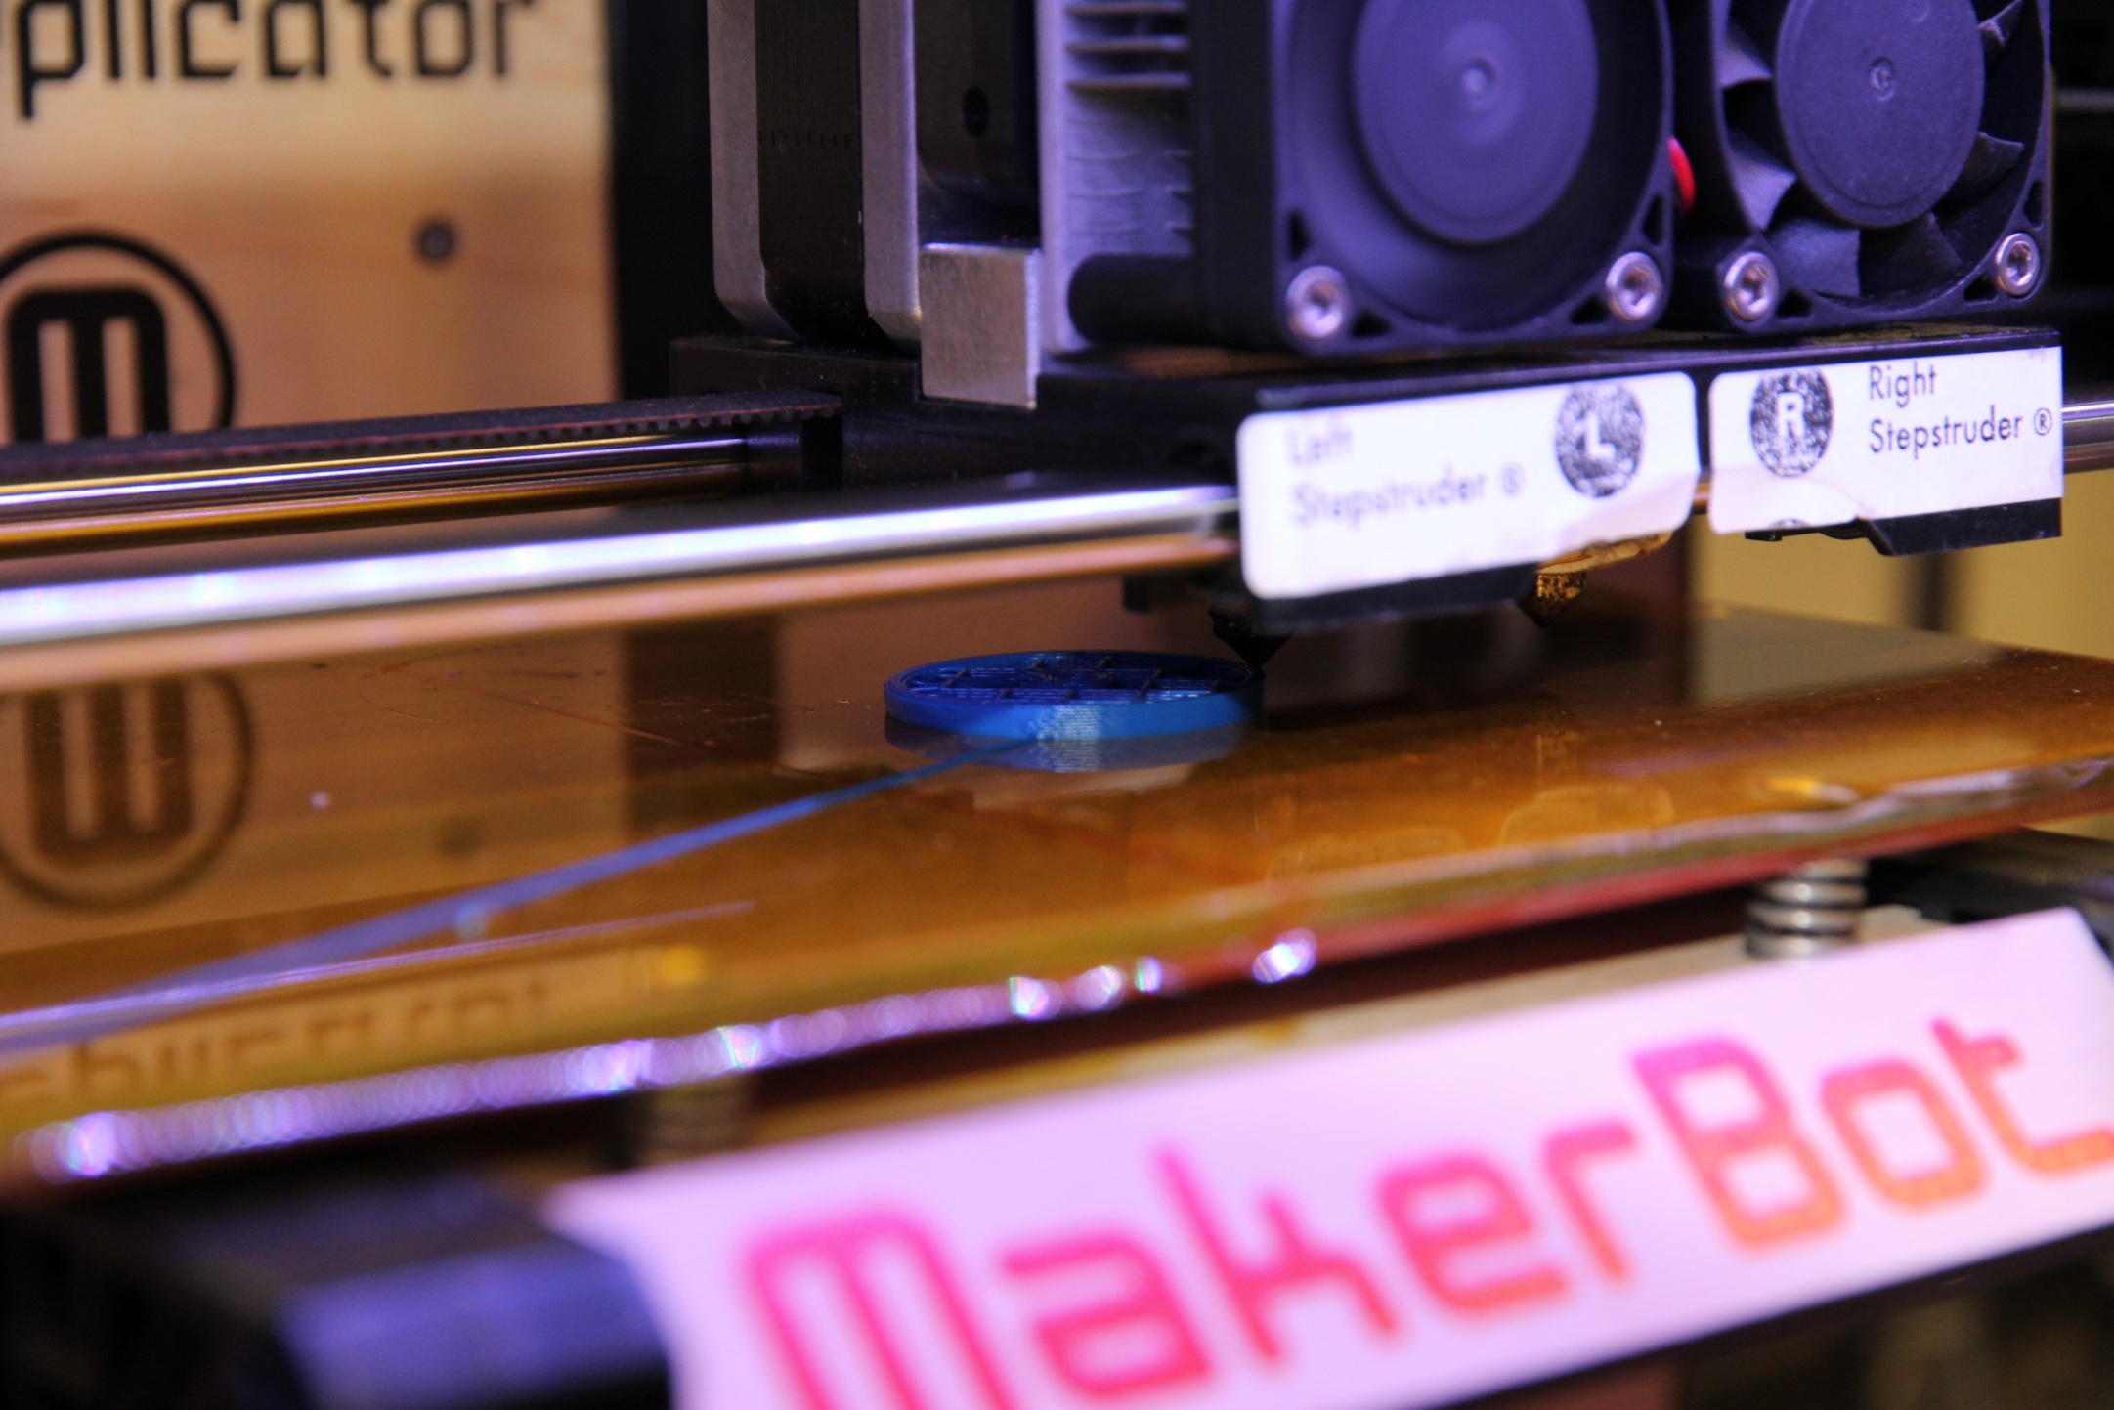
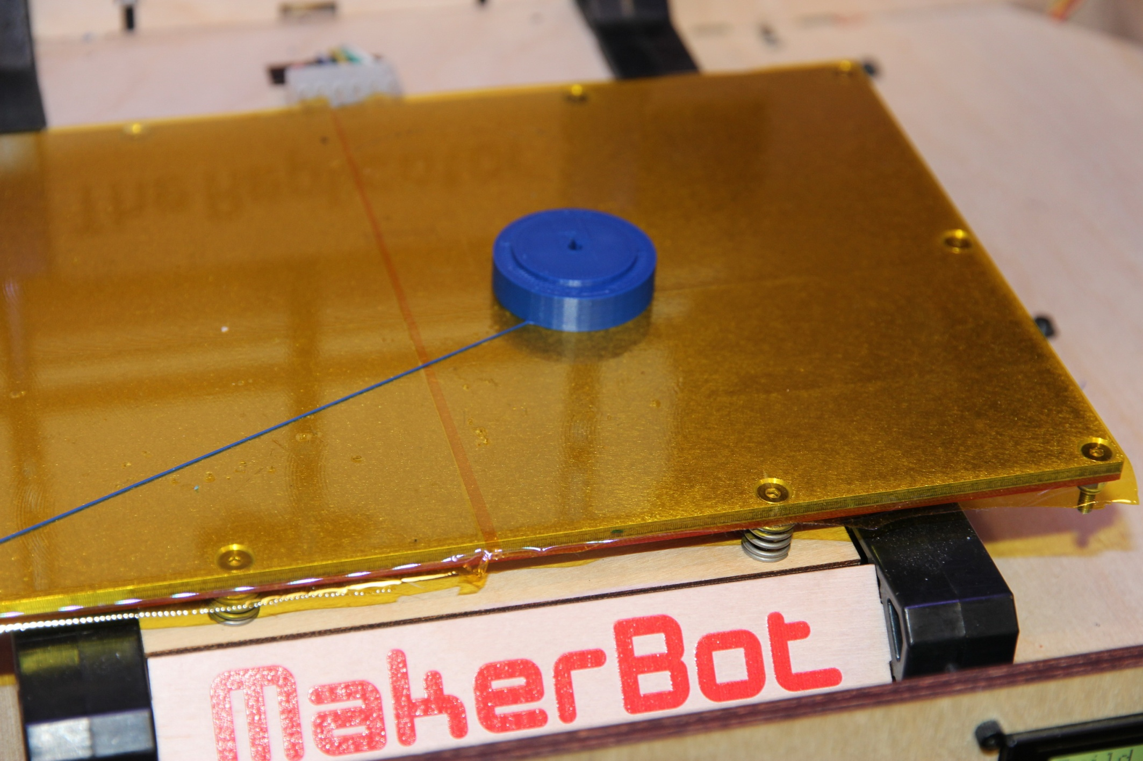
3D printing wheels

Slide 5
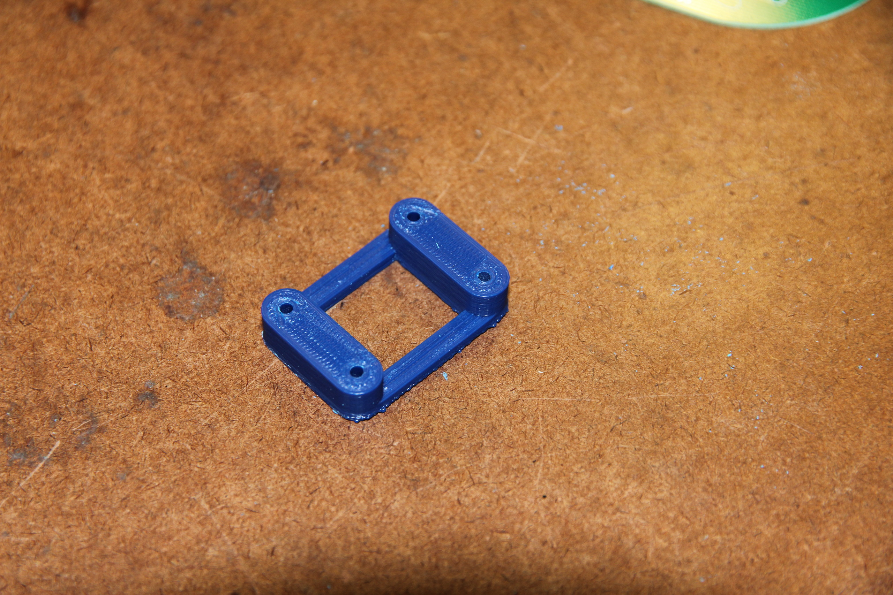
3D print motor mount

Slide 6
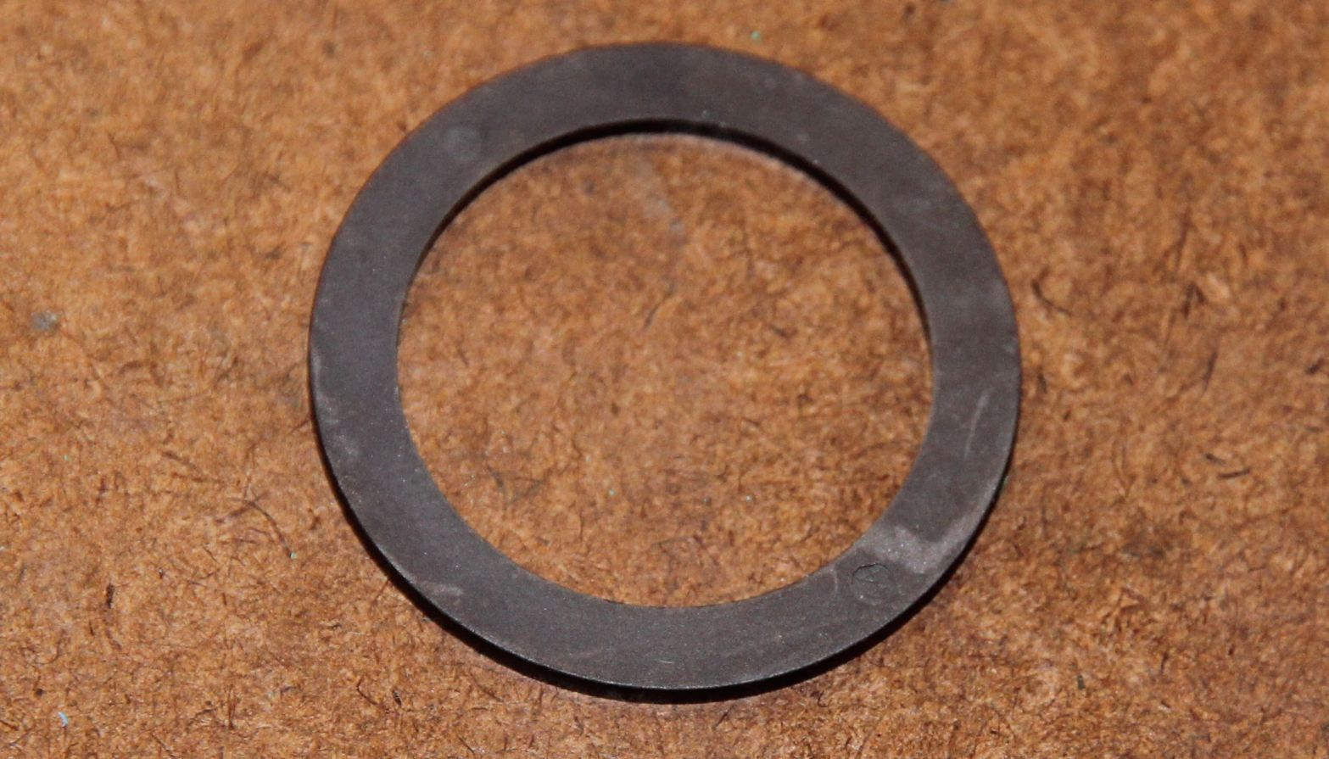
Magnets Ring AS5000-MR20-44
Make sure the mark here face to the wheel when assembling
→

Slide 7
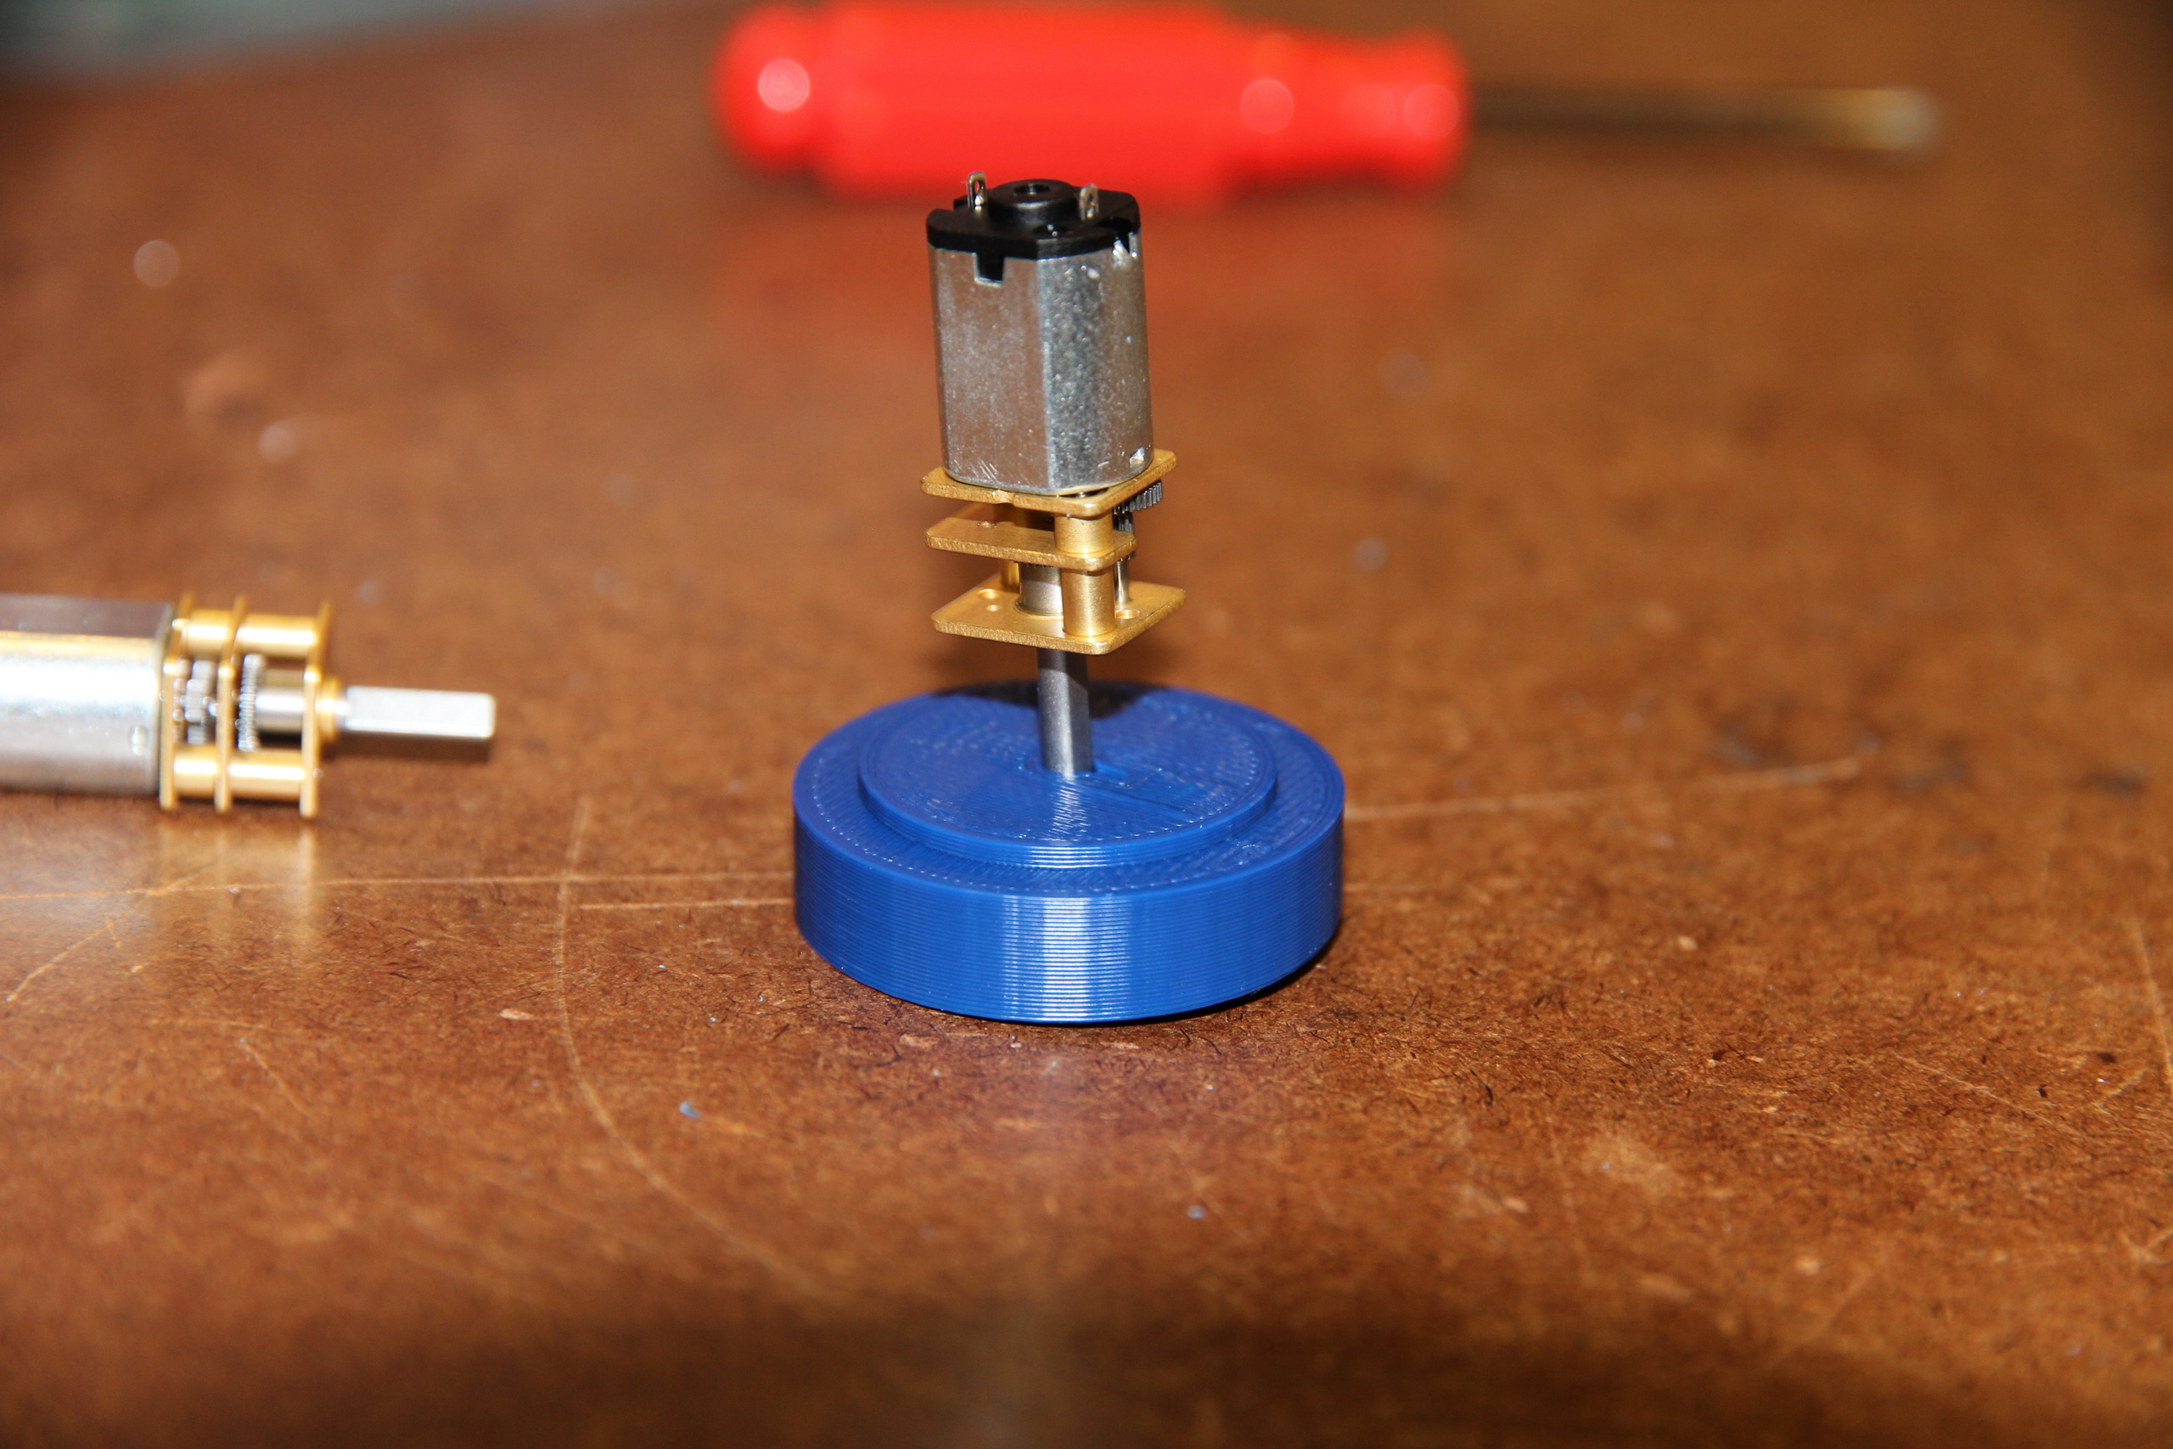
Push motor shaft into wheel carefully, it is pretty tight, don’t damage the motor.

Slide 8
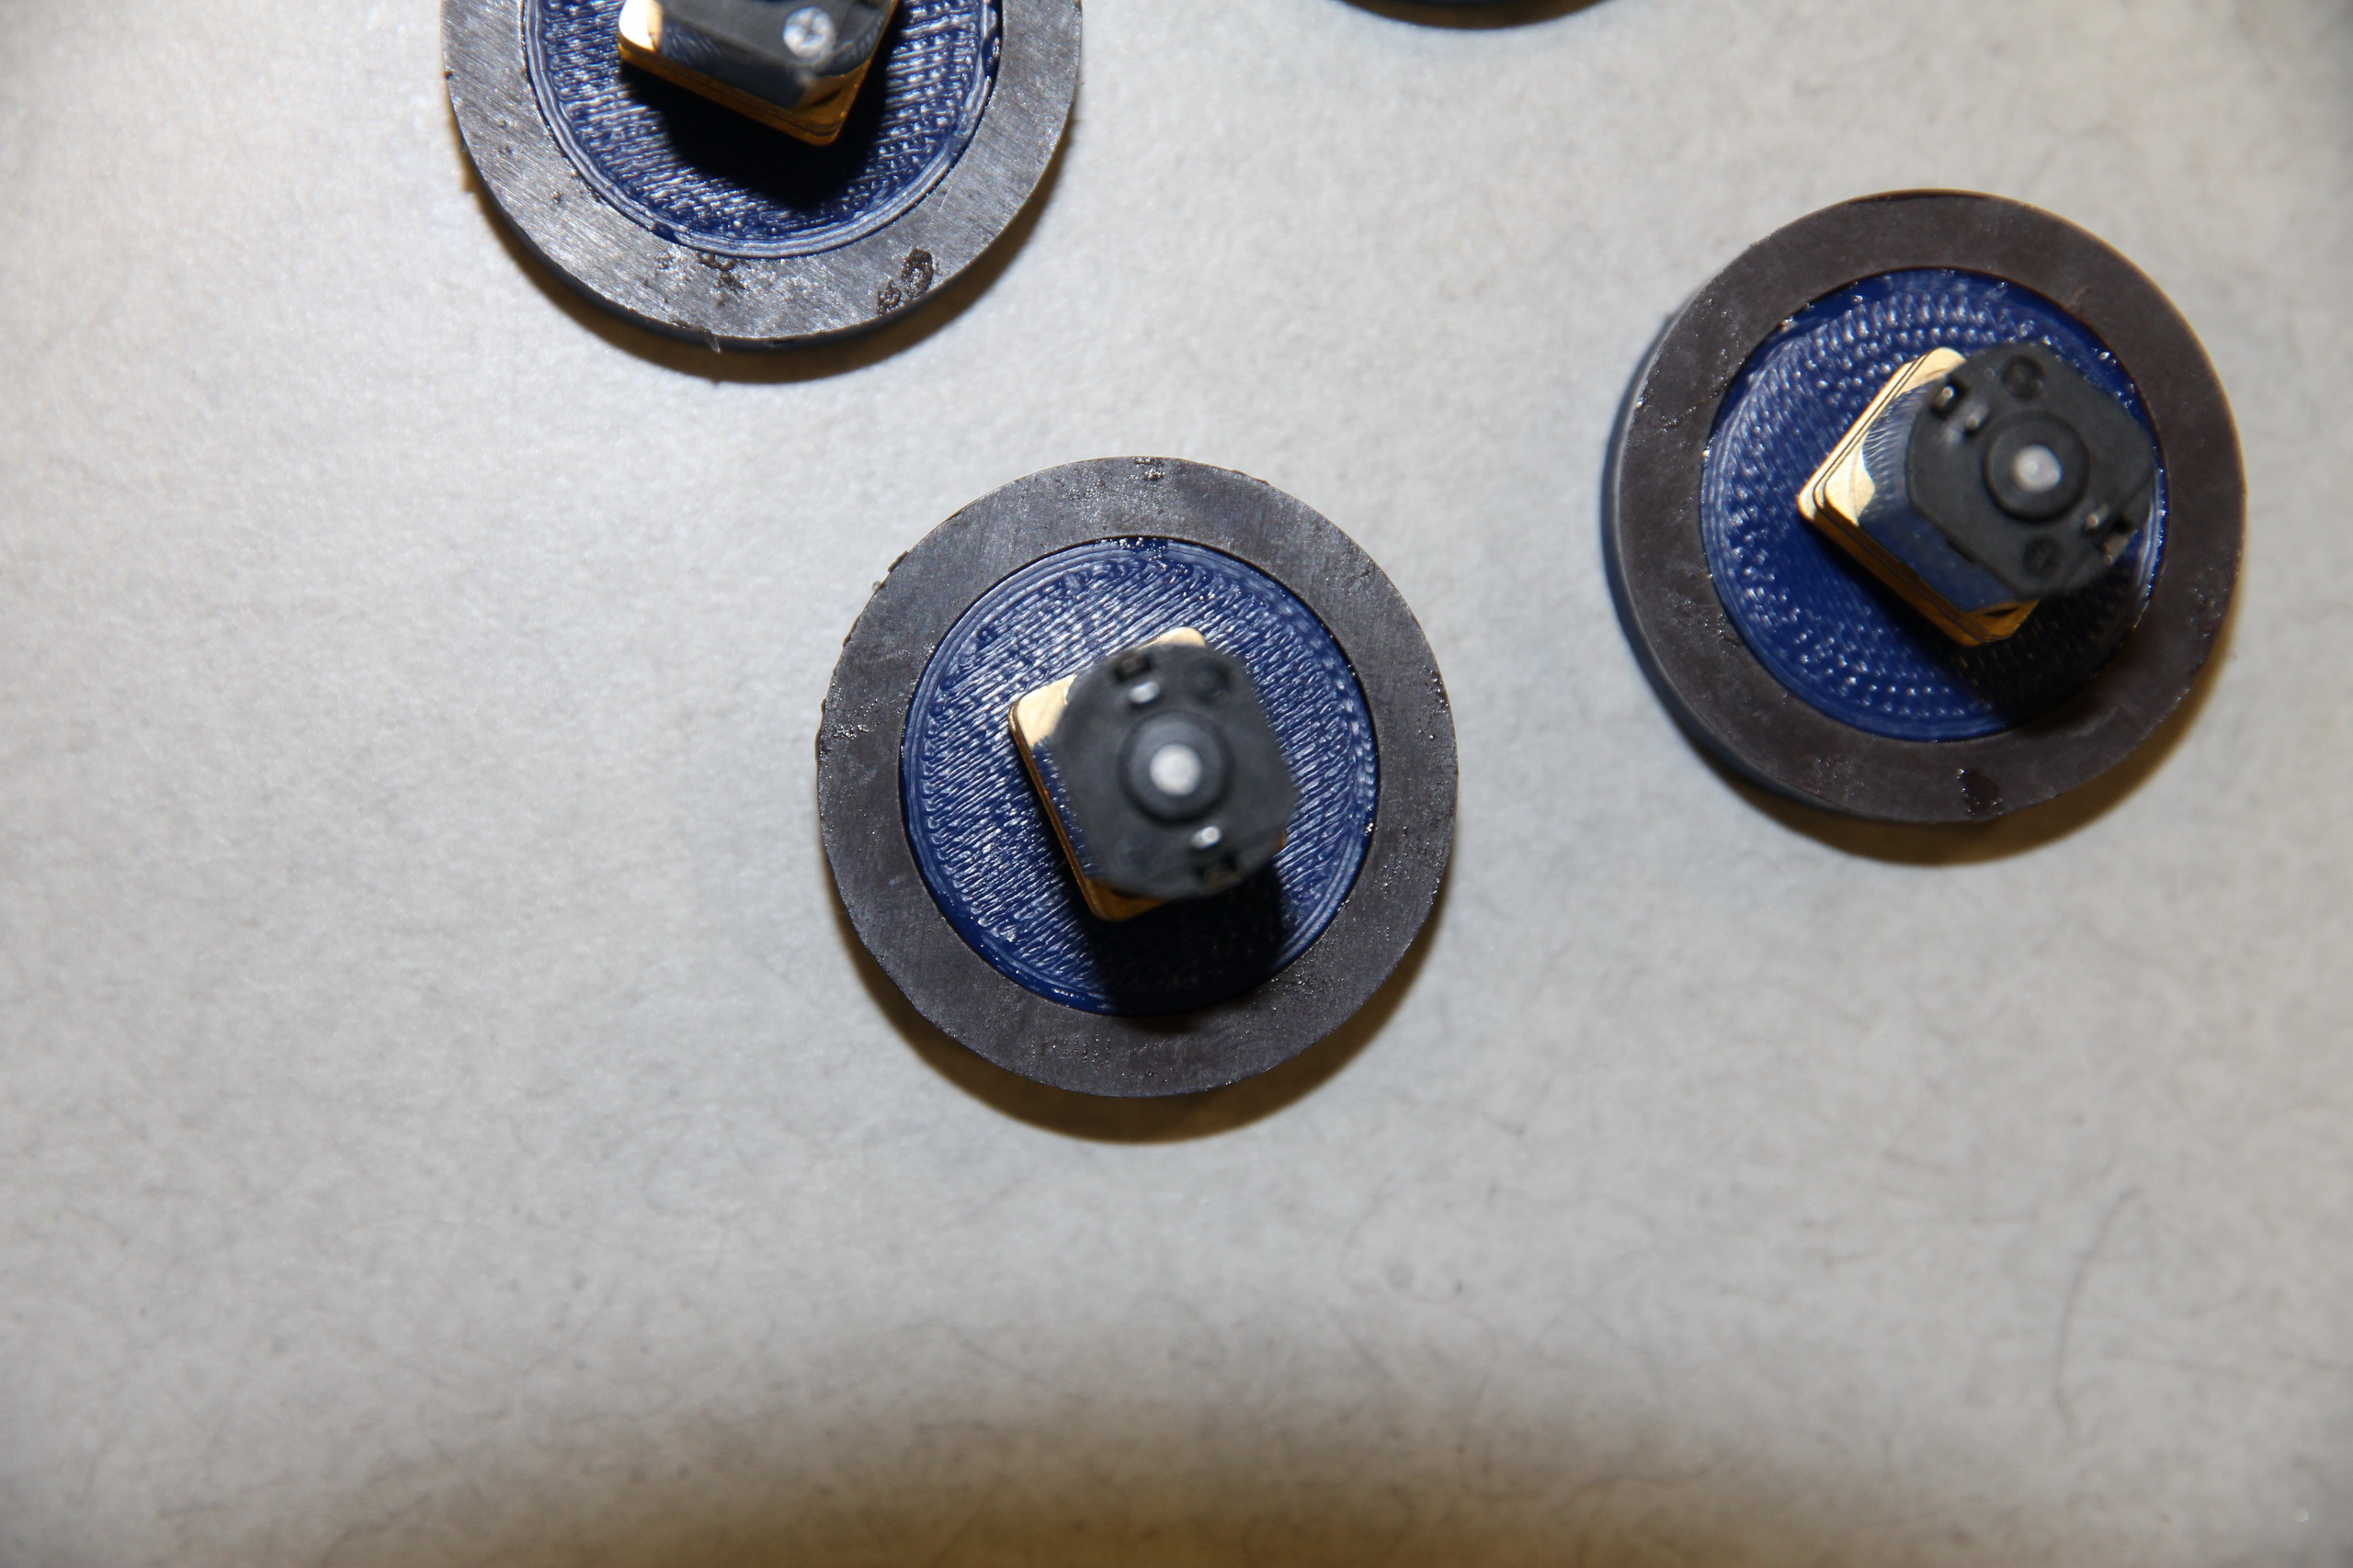
Glue magnets and wheel together with super glue (epoxy Wait recommended) until dry!

Slide 9
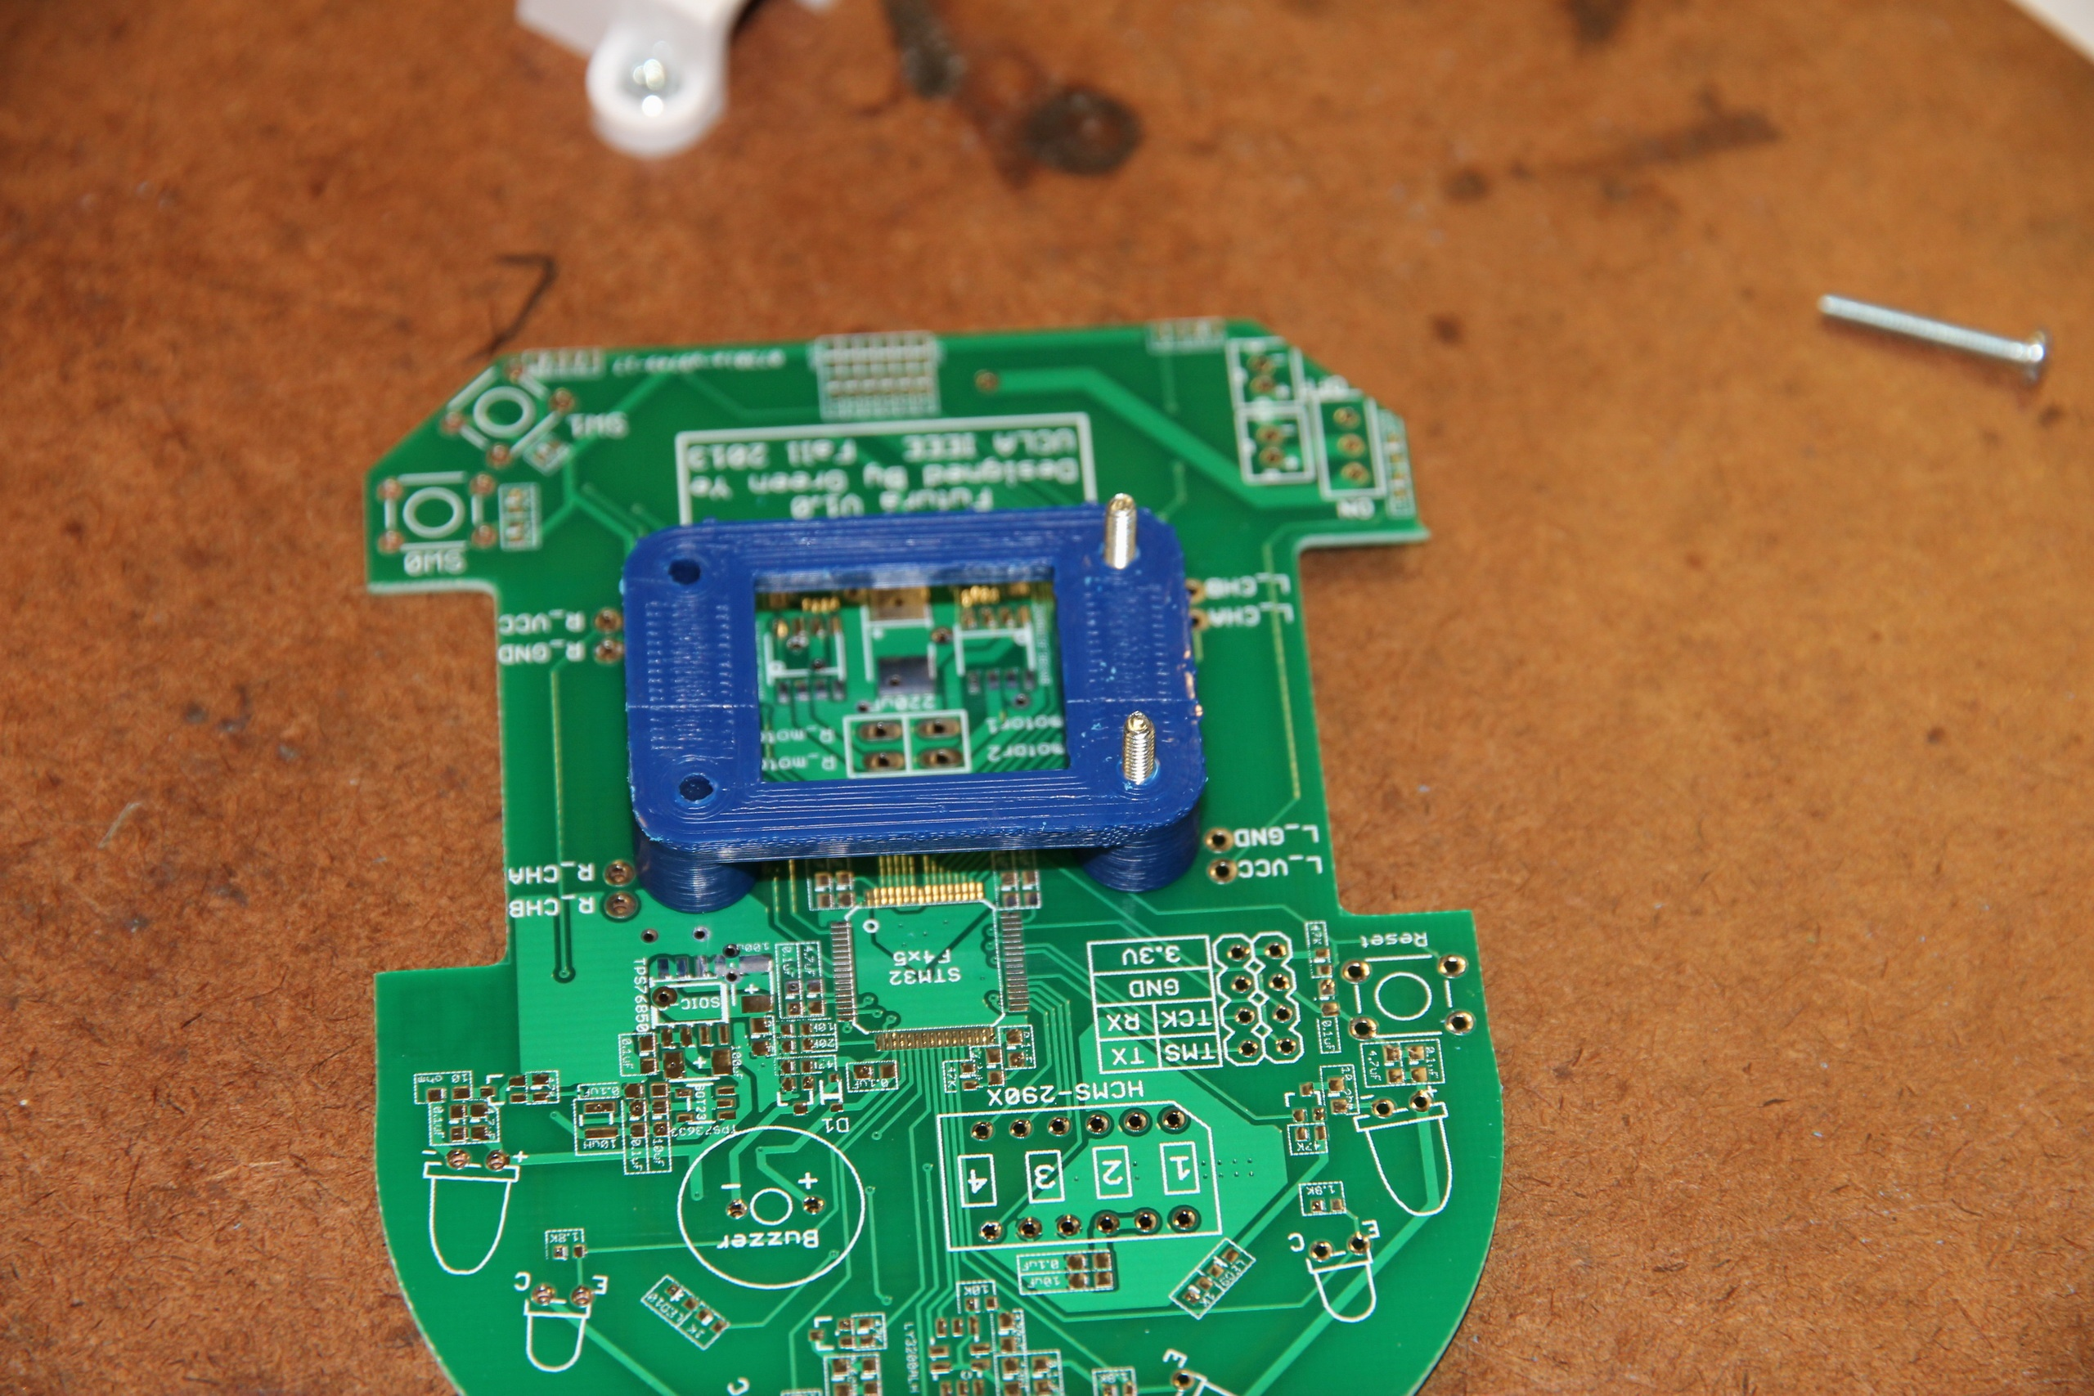
After you finish all soldering on PCB then place Motor mount on PCB
Get 2-56 x 20mm screws go through the PCB and mount

Slide 10
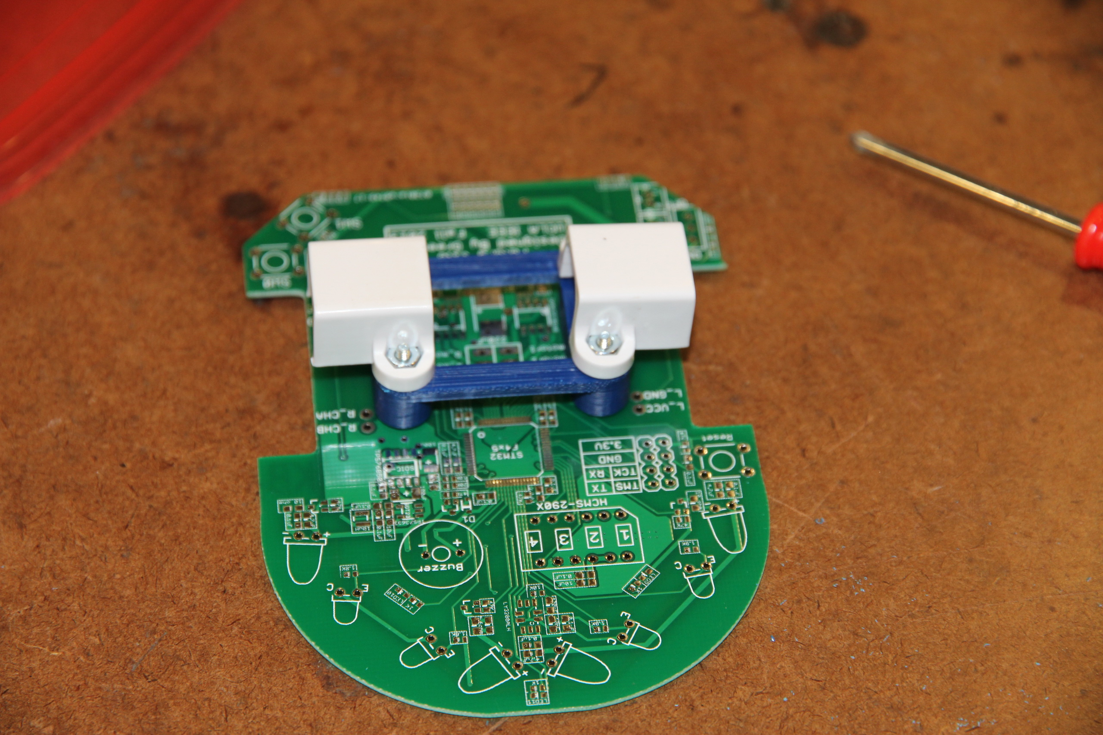
- Lock the brackets with 2-56 nuts come with brackets - Don’t all the way tighten the screw since we haven’t placed motors in

Slide 11
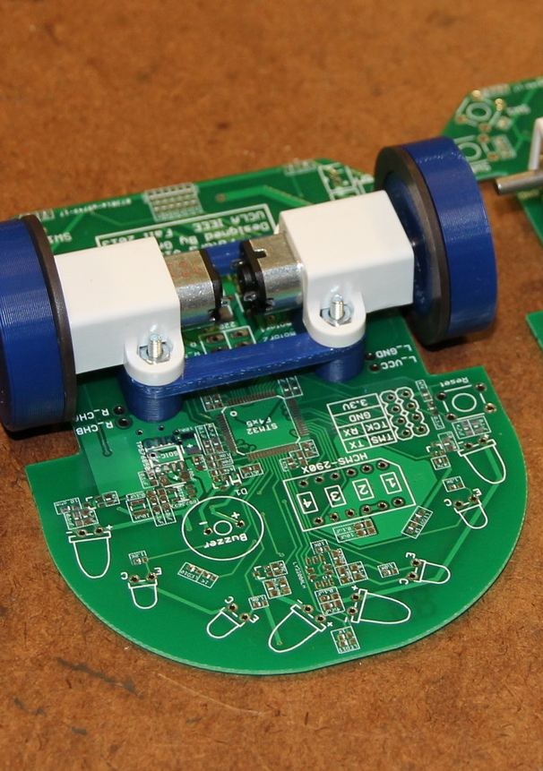
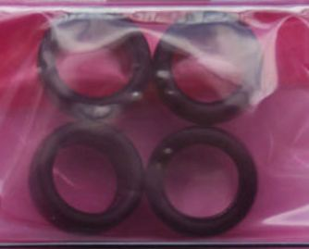
Put motors into bracket slots
Tighten all 4 screws
Put tire onto wheel(very tight, you might need to put tires on wheels before you put motors into brackets

Slide 12
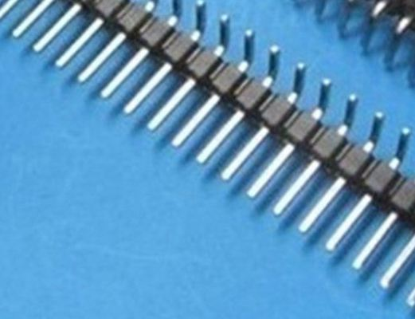
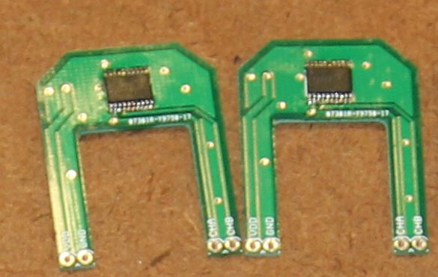
Solder encoder
Solder AS5304A onto encoder PCB
Have 2.54mm pitch male headers ready
Solder the straight side into encoder PCB

Slide 13
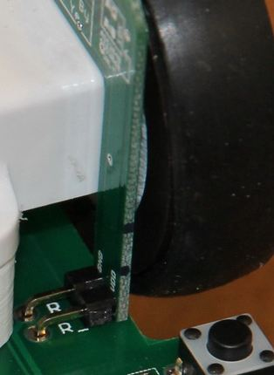
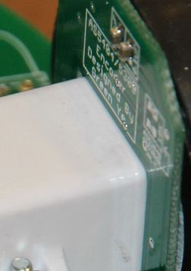
Mount Encoder
Place encoder board above motor bracket, make sure encoder IC is facing to the magnets with approx. 1mm
Insert the right angled side of male header into the encoder signal pins on mouse PCB
Solder the right angled side
Place hot glue here
before solder the male header onto PCB
Hot glue
here

Slide 14
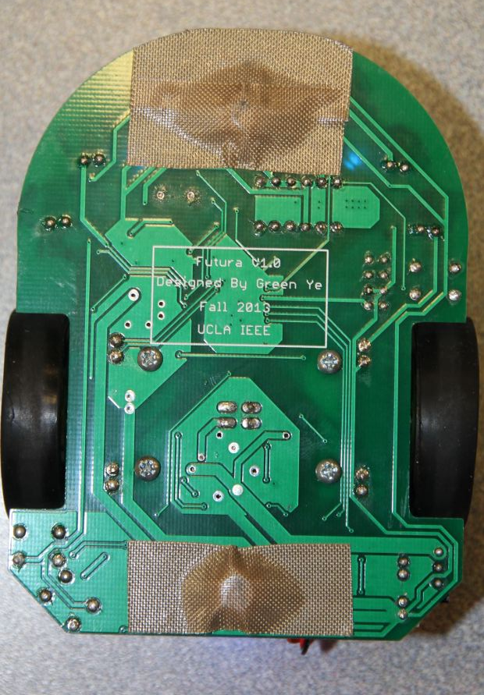
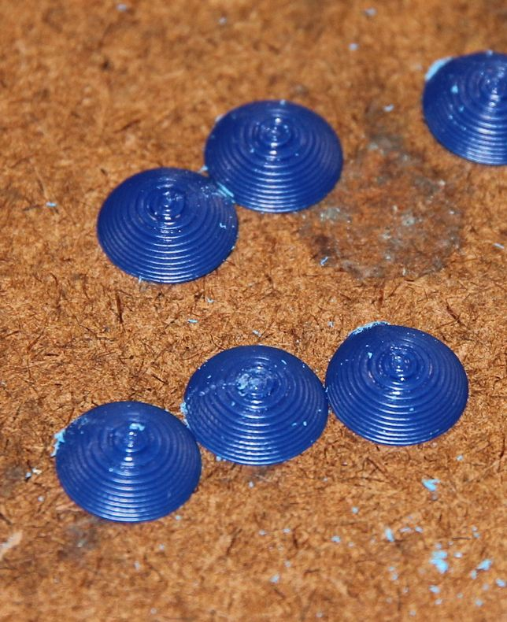
Skate Pad
Hot glue skate pads here
Cover with teflon tape
Sand the tip for a little bit

Slide 15
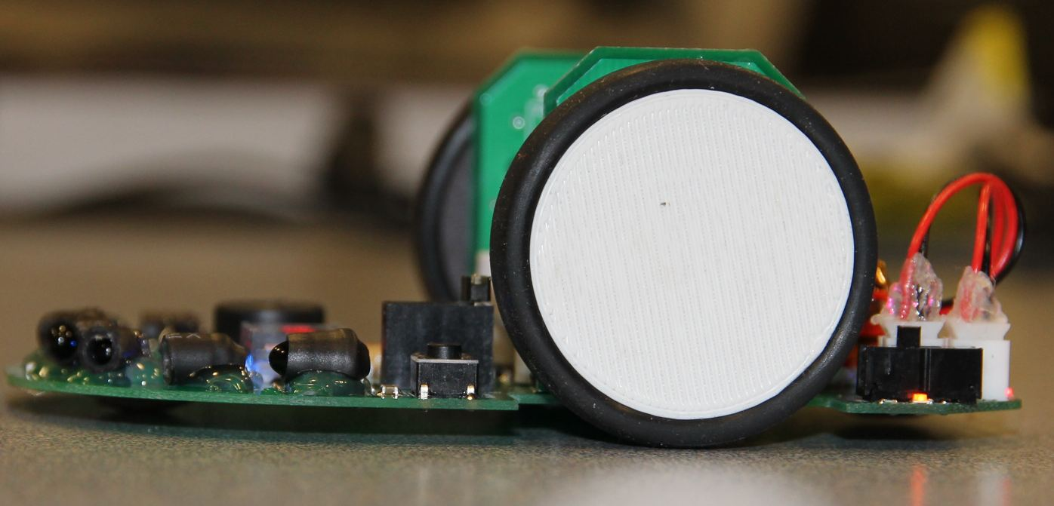
You are all set!

